Slide 1
6-12 April 2025
#EducationAtIEEE

Slide 2
A week-long celebration of educational resources from across IEEE
IEEE members and volunteers make an impact through education… highlight your content!
Join us all week:
Live and virtual events from groups across IEEE
Educational resources, websites, and scholarships
Special offers on education for IEEE members
Earn points and an Education Week digital badge for participating during the week
educationweek.ieee.org

Slide 3
Want to share the video?
Make sure to use this link:
https://ieeetv.ieee.org/video/ieee-education-week-educationatieee

Slide 4
IEEE Education Week Website
educationweek.ieee.org

Slide 5
The IEEE Education Week website features educational events and resources from across IEEE for anyone who is:

Slide 6
What Can You Submit? Some Suggestions:
Live Events
Resources
Special Offers
Educational websites
eLearning courses
Podcasts
Videos
Blogs
Journals
Live events or webinars scheduled for 14-20 April
Conferences
Hackathons
Tutorials
Other in-person or virtual events
Discounts on training courses
Membership discounts
Special access for IEEE members
Contests
Every IEEE group can contribute!

Slide 7
Two Ways to Submit Content…
IEEE vTools (Events)
Submit your educational event normally via vTools.
Select one of these Categories:
Professional – Continuing Education; Non-Technical – Pre-University Activities; or Pre-U STEM Program.
Event will be automatically added to the site (please allow time for update).
Education Week Website
(Events, Resources, Special Offers)
Use the form at educationweek.ieee.org/submit-an-ieee-event
to submit details about your offerings.
Submissions will be reviewed and then posted.

Slide 8
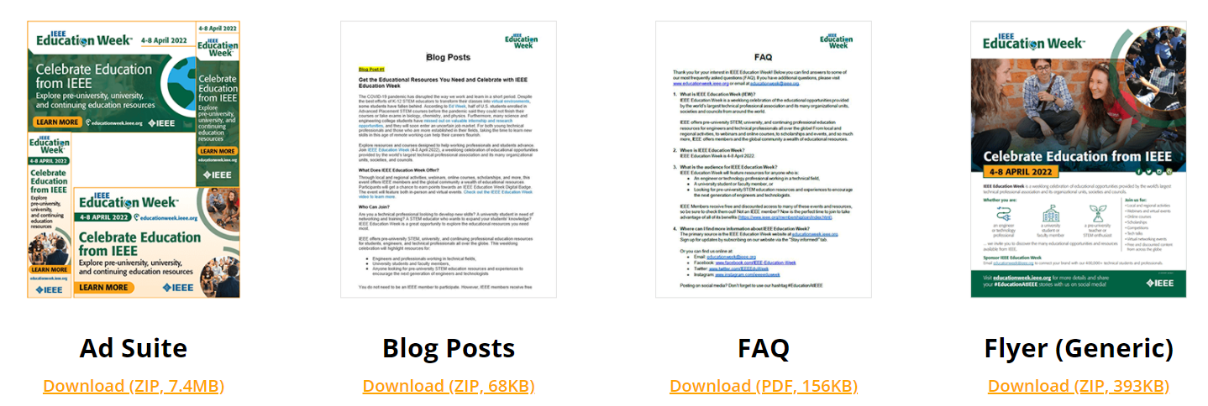
Help Us Spread the Word About Education Week!
https://educationweek.ieee.org/toolkit/

Slide 9
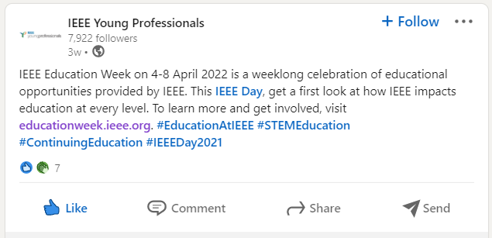
Education Week Hashtag
Please use the hashtag when promoting IEEE Education Week on social media
#EducationAtIEEE

Slide 10
Questions?

Slide 11
Thank You!
Email: EducationWeek@ieee.org
Web: https://educationweek.ieee.org/

