Slide 1

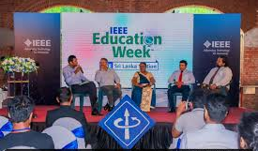
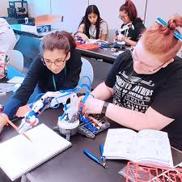
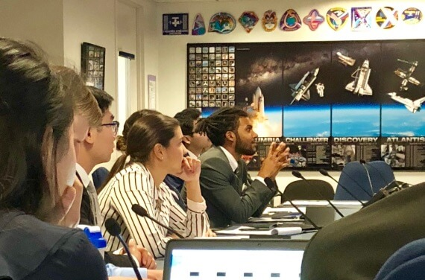
11-19
APRIL
2026
Celebrating IEEE’s impact in Pre-University STEM,
University and Continuing Professional Education
Increase visibility of educational offerings by
joining 100+ IEEE Operating Units globally
Collection of live/virtual educational events
Special offers and discounts on IEEE education
Resources highlighting education endeavors across IEEE
Centered around educationweek.ieee.org
For more information contact EducationWeek@ieee.org
SAVE THE DATE
Notes:
ROW

